Slide 1


Noida Institute of Engineering and Technology, Greater Noida
Design Pattern
Unit: I
Introduction to Design Pattern
Ibrar Ahmed
(Asst. Professor)
CSE Department
Course Details (B. Tech. 5th Sem)

Slide 2

Faculty Introduction
Name | Ibrar Ahmed
Qualification | M. Tech. (Computer Engineering)
Designation | Assistant Professor
Department | Computer Science & Engineering
Total Experience | 4 years
NIET Experience | 1 years
Subject Taught | Design & Analysis of Algorithm, Data Structures, Artificial Intelligence, Soft Computing, C Programming, Web Technology, Discrete Mathematics.

Slide 3
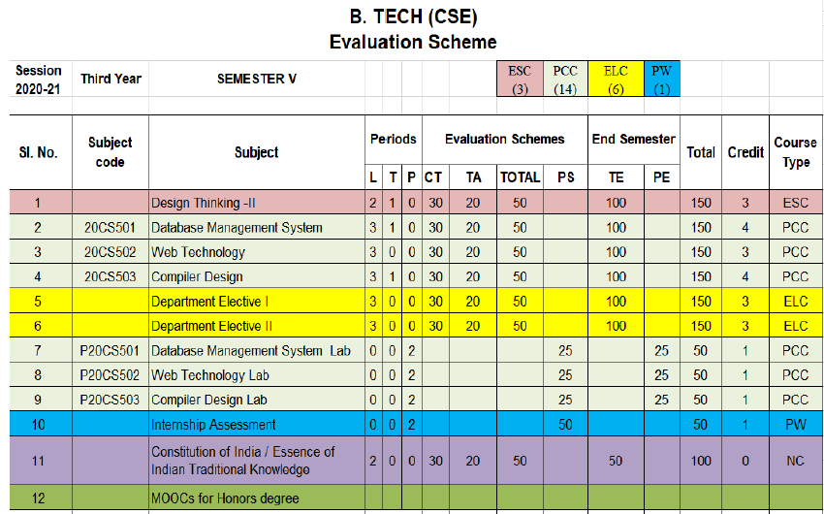
Evaluation Scheme
Python Web development with Django
Design Pattern

Slide 4
Syllabus
UNIT-I: Introduction of Design Pattern
Describing Design Patterns, Design Patterns in Smalltalk MVC, The Catalogue of Design Patterns, Organizing The Cato log, How Design Patterns solve, Design Problems, How to Select a Design pattern, How to Use a Design Pattern. Principle of least knowledge.

Slide 5
Syllabus
UNIT-II: Creational Design Pattern
A Case Study: Designing a Document Editor
Creational Patterns: Abstract Factory, Builder , Factory Method, Prototype , Singleton Pattern,

Slide 6
Syllabus
UNIT-III: Structural Design Pattern
Structural Pattern Part-I, Adapter, Bridge, Composite.
Structural Pattern Part-II, Decorator, Facade, Flyweight, Proxy.

Slide 7
Syllabus
UNIT-IV: Behavioral Design Patterns Part: I
Behavioral Patterns Part: I, Chain of Responsibility, Command, Interpreter, Iterator Pattern.
Behavioral Patterns Part: II, Mediator, Memento, Observer, Patterns.

Slide 8
Syllabus
UNIT-V: Behavioral Design Patterns Part: II
Behavioral Patterns Part: III, State, Strategy, Template Method, Visitor, What to Expect from Design Patterns.

Slide 9
Branch Wise Application
1. Real time web analytics
2. Digital Advertising
3. E-Commerce
4. Publishing
5. Massively Multiplayer Online Games
6. Backend Services and Messaging
7. Project Management & Collaboration
8. Real time Monitoring Services
9.Live Charting and Graphing
10. Group and Private Chat

Slide 10
Course Objective
In this semester, the students will
Study how to shows relationships and interactions between classes or objects..
Study to speed up the development process by providing well-tested, proven development/design paradigms.
Select a specific design pattern for the solution of a given design problem.
Create a catalogue entry for a simple design pattern whose purpose and application is understood.

Slide 11
Course Outcomes (COs)
At the end of course, the student will be able to:
CO1 : Construct a design consisting of collection of modules.
CO2 : Exploit well known design pattern such as Factory, visitor etc.
CO3 : Distinguish between different categories of design patterns.
CO4 : Ability to common design pattern for incremental development.
CO5 : Identify appropriate design pattern for a given problem and design the software using pattern oriented architecture.

Slide 12
Program Outcomes (POs)
Engineering Graduates will be able to:
PO1 : Engineering Knowledge
PO2 : Problem Analysis
PO3 : Design/Development of solutions
PO4 : Conduct Investigations of complex problems
PO5 : Modern tool usage
PO6 : The engineer and society

Slide 13
Program Outcomes (POs)
Engineering Graduates will be able to:
PO7 : Environment and sustainability
PO8 : Ethics
PO9 : Individual and teamwork
PO10 : Communication
PO11 : Project management and finance
PO12 : Life-long learning

Slide 14

COs - POs Mapping
CO.K | PO1 | PO2 | PO3 | PO4 | PO5 | PO6 | PO7 | PO8 | PO9 | PO10 | PO11 | PO12
CO1 | 2 | 2 | 2 | 3 | 3 | - | - | - | - | - | - | -
CO2 | 3 | 2 | 3 | 2 | 3 | - | - | - | - | - | - | -
CO3 | 3 | 2 | 3 | 2 | 3 | - | - | - | - | - | - | -
CO4 | 3 | 2 | 3 | 2 | 3 | - | - | - | - | - | - | -
CO5 | 3 | 2 | 3 | 3 | 3 | - | - | - | - | - | - | -
AVG | 2.8 | 2.0 | 2.8 | 2.4 | 3.0 | - | - | - | - | - | - | -

Slide 15
Program Specific Outcomes(PSOs)
S. No. | Program Specific Outcomes (PSO) | PSO Description
1 | PSO1 | Understand to shows relationships and interactions between classes or objects of a pattern.
2 | PSO2 | Study to speed up the development process by providing well-tested, proven development
3 | PSO3 | Select a specific design pattern for the solution of a given design problem
4 | PSO4 | Create a catalogue entry for a simple design pattern whose purpose and application is understood.

Slide 16
COs - PSOs Mapping
CO.K | PSO1 | PSO2 | PSO3 | PSO4
CO1 | 3 | - | - | -
CO2 | 3 | 3 | - | -
CO3 | 3 | 3 | - | -
CO4 | 3 | 3 | - | -
CO5 | 3 | 3 | - | -

Slide 17
Program Educational Objectives (PEOs)
Program Educational Objectives (PEOs) | PEOs Description
PEOs | To have an excellent scientific and engineering breadth so as to comprehend, analyze, design and provide sustainable solutions for real-life problems using state-of-the-art technologies.
PEOs | To have a successful career in industries, to pursue higher studies or to support entrepreneurial endeavors and to face the global challenges.
PEOs | To have an effective communication skills, professional attitude, ethical values and a desire to learn specific knowledge in emerging trends, technologies for research, innovation and product development and contribution to society.
PEOs | To have life-long learning for up-skilling and re-skilling for successful professional career as engineer, scientist, entrepreneur and bureaucrat for betterment of society.

Slide 18
Result Analysis(Department Result & Subject Result & Individual result
Name of the faculty | Subject code | Result % of clear passed
Mr. Sanjay Nayak

Slide 19

Pattern of Online External Exam Question Paper (100 marks)

Slide 20
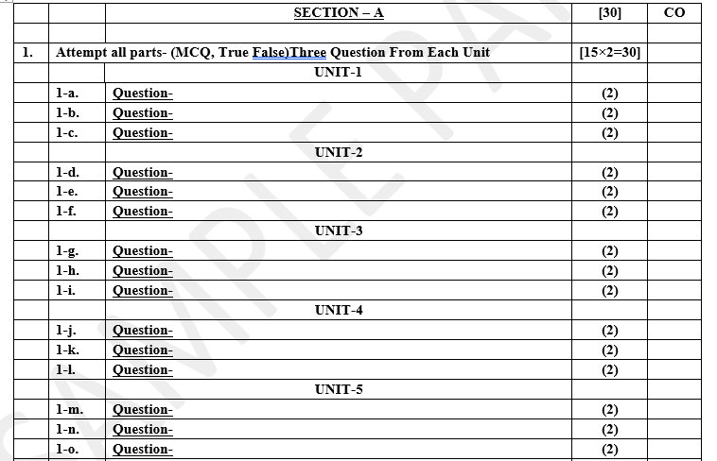
Pattern of Online External Exam Question Paper (100 marks)

Slide 21
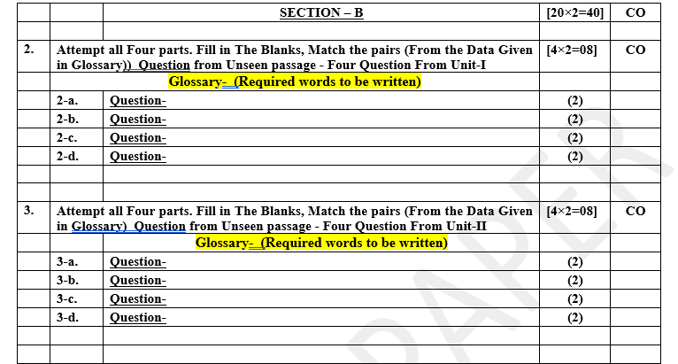
Pattern of Online External Exam Question Paper (100 marks)

Slide 22

Pattern of Online External Exam Question Paper (100 marks)

Slide 23

Pattern of Online External Exam Question Paper (100 marks)

Slide 24
Prerequisite / Recap
Student should have knowledge of object oriented analysis and design.
Knowledge of Data structure and algorithm.
knowledge of Programing language such as C/C++ etc.
Good problem solving Skill .

Slide 25
Brief Introduction about the Subject with videos
YouTube /other Video Links
https://youtu.be/rI4kdGLaUiQ?list=PL6n9fhu94yhUbctIoxoVTrklN3LMwTCmd
https://youtu.be/v9ejT8FO-7I?list=PLrhzvIcii6GNjpARdnO4ueTUAVR9eMBpc
https://youtu.be/VGLjQuEQgkI?list=PLt4nG7RVVk1h9lxOYSOGI9pcP3I5oblbx

Slide 26
Unit I Content
Describing Design Patterns.
Design Patterns in Smalltalk MVC.
The Catalogue of Design Patterns.
Organizing The Cato log.
How Design Patterns solve.
Design Problems.
How to Select a Design pattern.
How to Use a Design Pattern.

Slide 27
Unit I Objective
In Unit I, the students will be able to find
Definitions of terms and concepts.
The idea of a pattern.
The origins of design patterns.
Patterns in software design.
Scope of development activity: applications, toolkits, frameworks.
The Portland Pattern Repository.

Slide 28
Topic Objective
Topic : Describing design patterns
In this topic, the students will gain , The idea of a pattern and the definition of terms and concepts, what are the role of patterns and how they are used in software design.

Slide 29
Design Pattern - Overview
Design patterns represent the best practices used by experienced object- oriented software developers.
Design patterns are solutions to general problems that software developers faced during software development.
These solutions were obtained by trial and error by numerous software developers over quite a substantial period of time.

Slide 30
Design Pattern – Overview Cont………
What is Gang of Four (GOF)?
In 1994, four authors Erich Gamma, Richard Helm, Ralph Johnson and John Vlissides published a book titled Design Patterns - Elements of Reusable Object-Oriented Software which initiated the concept of Design Pattern in Software development.
These authors are collectively known as Gang of Four (GOF). According to these authors design patterns are primarily based on the following principles of object orientated design.

Slide 31
Design Pattern – Overview Cont………
principles of object orientated design:-
Program to an interface not an implementation.
Favor object composition over inheritance.

Slide 32
Design Pattern – Overview Cont………
Usage of Design Pattern:
Design Patterns have two main usages in software development.
Common platform for developers:-
Design patterns provide a standard terminology and are specific to particular scenario. For example, a singleton design pattern signifies use of single object so all developers familiar with single design pattern will make use of single object and they can tell each other that program is following a singleton pattern.

Slide 33
Design Pattern – Overview Cont………
Usage of Design Pattern:
Design Patterns have two main usages in software development.
2. Best Practices:-
Design patterns have been evolved over a long period of time and they provide best solutions to certain problems faced during software development. Learning these patterns helps unexperienced developers to learn software design in an easy and faster way.

Slide 34
Design Pattern – Overview Cont………
Types of Design Patterns:-
As per the design pattern reference book Design Patterns - Elements of Reusable Object-Oriented Software , there are 23 design patterns which can be classified in three categories: Creational, Structural and Behavioral patterns.
We'll also discuss another category of design pattern: J2EE design patterns.

Slide 35
Design Pattern – Overview Cont………
Types of Design Patterns:-
Creational Patterns:-
These design patterns provide a way to create objects while hiding the creation logic, rather than instantiating objects directly using new operator. This gives program more flexibility in deciding which objects need to be created for a given use case.

Slide 36
Design Pattern – Overview Cont………
Types of Design Patterns:-
2. Structural Patterns:-
These design patterns concern class and object composition. Concept of inheritance is used to compose interfaces and define ways to compose objects to obtain new functionalities.

Slide 37
Design Pattern – Overview Cont………
Types of Design Patterns:-
3. Behavioral Patterns:-
Behavioral design patterns are concerned with the interaction and responsibility of objects.
In these design patterns, the interaction between the objects should be in such a way that they can easily talk to each other and still should be loosely coupled.

Slide 38
Topic Objective
Topic : Design Patterns in Smalltalk MVC
In this topic, the students will gain , The idea of design pattern in Smalltalk MVC, they understand what are the model ,view and controller defined by small talk.

Slide 39
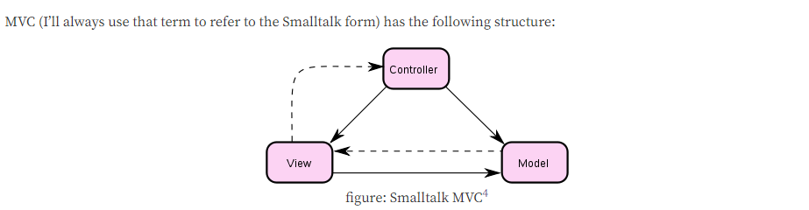
Design Patterns in Smalltalk MVC
Smalltalk MVC is defined in Design Pattern as:-
MVC Consists of three kinds of objects. The Model is the application object, the View is its screen presentation, and the Controller defines the way the user interface reacts to user input.

Slide 40
Design Patterns in Smalltalk MVC Cont…….
MVC Pattern stands for Model-View-Controller Pattern. This pattern is used to separate application's concerns:-
Model - Model represents an object or JAVA POJO carrying data. It can also have logic to update controller if its data changes.
View - View represents the visualization of the data that model contains.
Controller - Controller acts on both model and view. It controls the data flow into model object and updates the view whenever data changes. It keeps view and model separate.

Slide 41
Design Patterns in Smalltalk MVC Cont…….
Implementation:-
We are going to create a Student object acting as a model. Student View will be a view class which can print student details on console and Student Controller is the controller class responsible to store data in Student object and update view Student View accordingly.
MVC Pattern Demo, our demo class, will use Student Controller to demonstrate use of MVC pattern.

Slide 42
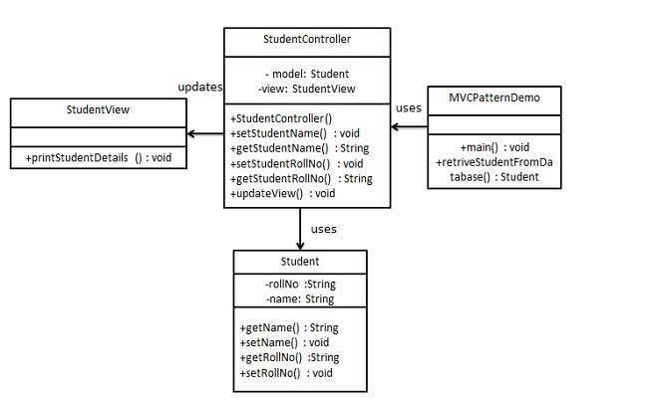
Design Patterns in Smalltalk MVC Cont…….
Implementation:-

Slide 43
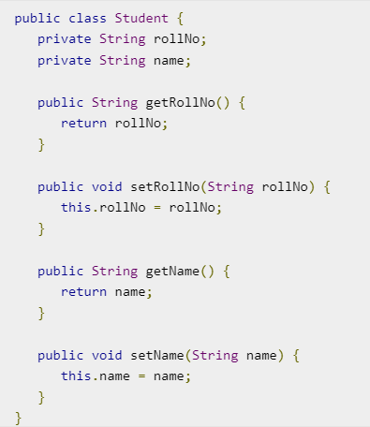
Design Patterns in Smalltalk MVC Cont…….
Step 1 :-
Create Student object Model
(Student.java)

Slide 44
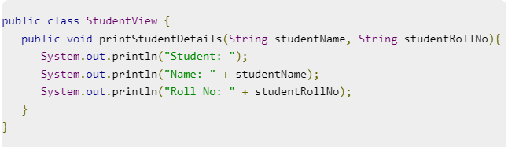
Design Patterns in Smalltalk MVC Cont…….
Step 2:- Create View (StudentView.java)

Slide 45
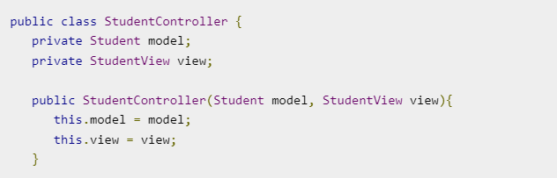
Design Patterns in Smalltalk MVC Cont…….
Step 3:-
Create Controller
(StudentController.java)

Slide 46
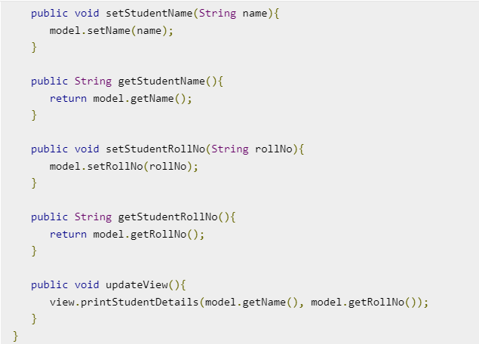
Design Patterns in Smalltalk MVC Cont…….
Step 3:-
Create Controller
(StudentController.java)

Slide 47
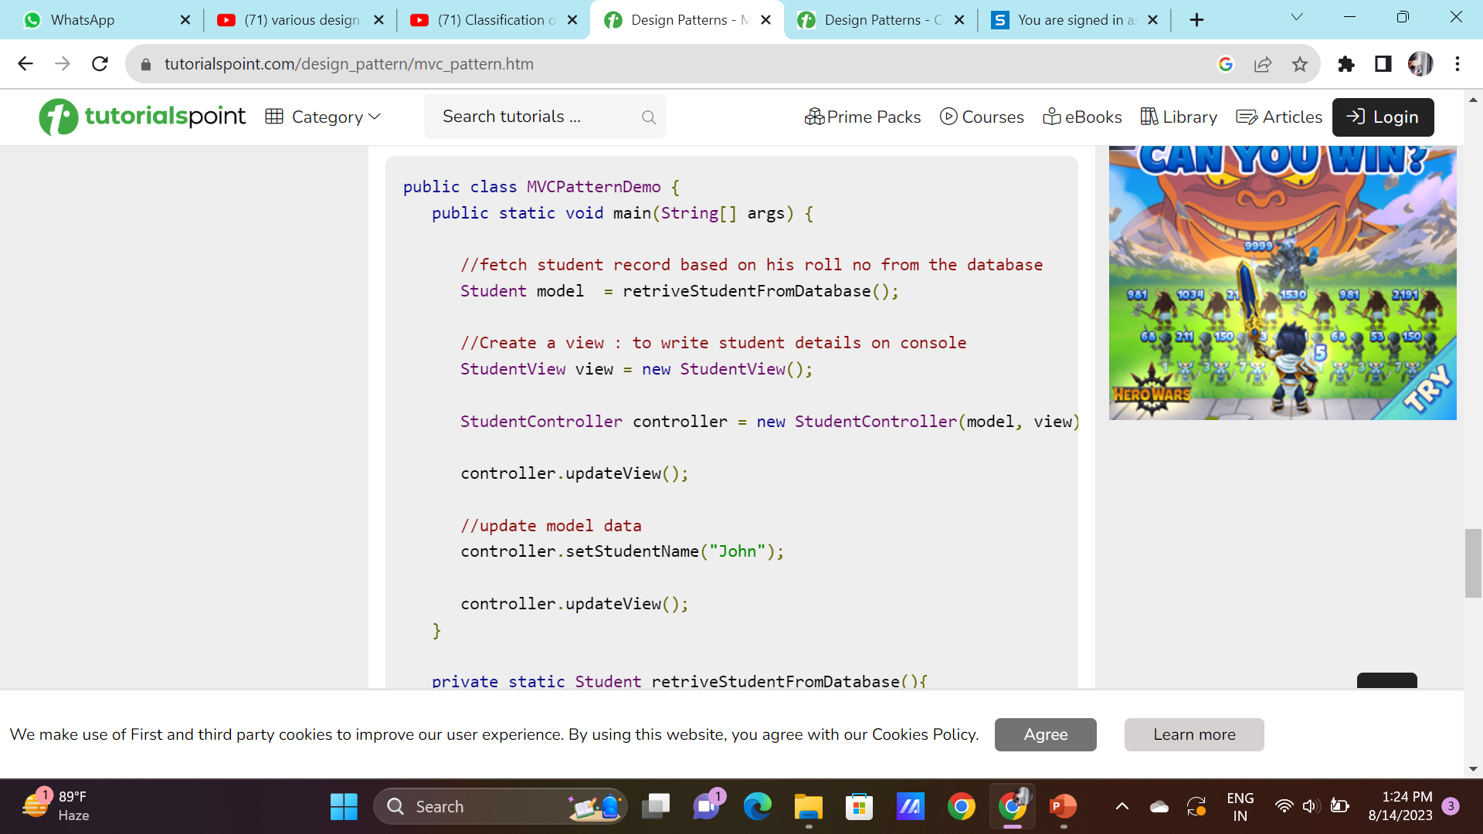
Design Patterns in Smalltalk MVC Cont…….
Step 4:-
Use the Student
Controller methods
to demonstrate
MVC design pattern
(MVCPatternDemo.java)

Slide 48
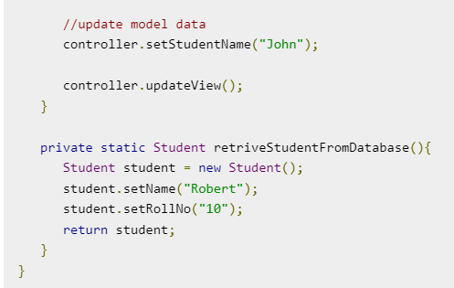
Design Patterns in Smalltalk MVC Cont…….
Step 4:-
Use the Student Controller methods to demonstrate MVC design pattern
(MVCPatternDemo.java)

Slide 49
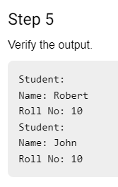
Design Patterns in Smalltalk MVC Cont…….

Slide 50
1) MVC is composed of three components, these are ?
Member Vertical Controller
Model Variable Centered
Model View Controller
Member Vertical Controller
2) What are the advantages of MVC?
MVC segregates your project into a different segment, and it becomes easy for developers to work on
It is easy to edit or change some part of your project that makes project less development and maintenance cost
MVC makes your project more systematic
All of the mentioned

Slide 51
3) What is the disadvantages of MVC model?
The model pattern is little complex
Multiple technologies knowledge is required
You need multiple programmers for parallel development
All of the mentioned above
4) In MVC, the model is responsible for managing the data of the application. A) True B) False
5) Controller directly refers the view or manipulates it. A) True B) False

Slide 52
Topic Objective
Topic : The Catalog of Design Patterns
In this topic, the students will gain , The idea of design pattern in The catalog grouped by intent, complexity, and popularity. The catalog contains all classic design patterns and several architectural Patterns that are used in software engineering.

Slide 53
The Catalog of Design Patterns
The Design Patterns are organized into a form of a catalog.
These Design Patterns collectively assist in software engineering by finding objects, specifying objects implementations, objects interfaces, determining objects granularity, implementing reuse mechanisms, etc. The Intents specify what the design pattern does.
Some of the patterns with their names and intents are as follows

Slide 54
The Catalog of Design Patterns Cont……
Factory Method: In Factory pattern, we create object without exposing the creation logic to the client and refer to newly created object using a common interface. Subclasses are responsible to create the instance of the class.
Abstract Factory: an interface is responsible for creating a factory of related objects without explicitly specifying their classes. Each generated factory can give the objects as per the Factory pattern.
Adaptor: This pattern involves a single class which is responsible to join functionalities of independent or incompatible interfaces. To provide the interface according to client requirement while using the services of a class with a different interface.
Bridge: It Separates abstraction from its implementation to make them independent.

Slide 55
The Catalog of Design Patterns Cont……
Builder: builds a complex object using simple objects and using a step by step approach.
Chain Of Responsibility: It Enables the handling of command objects by passing them to other objects by using the logic present in the processing of objects. In this pattern, normally each receiver contains reference to another receiver. If one object cannot handle the request then it passes the same to the next receiver and so on.
Command: A request is wrapped under an object as command and passed to invoker object. Invoker object looks for the appropriate object which can handle this command and passes the command to the corresponding object which executes the command.

Slide 56
The Catalog of Design Patterns Cont……
Composite: It represents the objects in a tree structure where each object represents the same interface. This enables clients to treat individual objects and their compositions uniformly. This pattern creates a class that contains group of its own objects. This class provides ways to modify its group of same objects.
Decorator: allows a user to add new functionality to an existing object without altering its structure at run time.
Facade: hides the complexities of the system and provides an interface to the client using which the client can access the system. Describes a higher-level interface that makes the sub-system easier to use.

Slide 57
The Catalog of Design Patterns Cont……
Flyweight: It Performs sharing of common objects properties by a large number of objects to save space.
Interpreter: It Deals with the implementation of a specified computer language that solves specific problems. It interprets sentences in language by representing the grammar of language along with an interpreter.
Iterator: It Enables sequential aggregate objects elements by hiding their underlying representations.
Mediator: It provides a unified interface to the set of interfaces in a subsystem. It provides loose coupling which enables objects to refer to each explicitly and also varies objects interaction independently.

Slide 58
The Catalog of Design Patterns Cont……
Momento: It supports the rollback mechanism by enabling the objects, to restore to their previous state without violation of encapsulation.
Observer: Whenever an object changes its state, it raises an event that notifies other objects and updates them automatically. This defines a one-to-many dependency between the objects.
Prototype: Here Prototypical instance determines the type of objects to be created. Further new objects are created by cloning this prototype.
proxy: It provides an illusion by applying placeholder to other objects in order to have control over it.

Slide 59
The Catalog of Design Patterns Cont……
Singleton: It Provides restrictions on instantiating a class to a single object and also makes it globally accessible.
State: It Permits an alteration in the object’s behavior with alteration in its state that is allows objects type to change at runtime.
Visitors: It Describes the skeleton of a program, enables subclasses to define some steps of the algorithm, and also to redefine certain steps without affecting the structure of the algorithm.
Strategy: It defines the Family of algorithms and their selection based upon the clients.

Slide 60
Topic Objective
Topic : Organizing the Catalog
In this topic, the students will learn how to organized the catalog As there are many design patterns, So they can organize or classify patterns to learn them faster.

Slide 61
Organizing the Catalog
Design patterns vary in their granularity and level of abstraction. Because there are many design patterns, we need a way to organize them. This section classifies design patterns so that we can refer to families of related patterns. The classification helps you learn the patterns in the catalog faster, and it can direct efforts to find new patterns as well.
We classify design patterns by two criteria. The first criterion, called purpose, reflects what a pattern does. Patterns can have either creational, structural, or behavioral purpose. Creational patterns concern the process of object creation. Structural patterns deal with the composition of classes or objects. Behavioral patterns characterize the ways in which classes or objects interact and distribute responsibility.

Slide 62
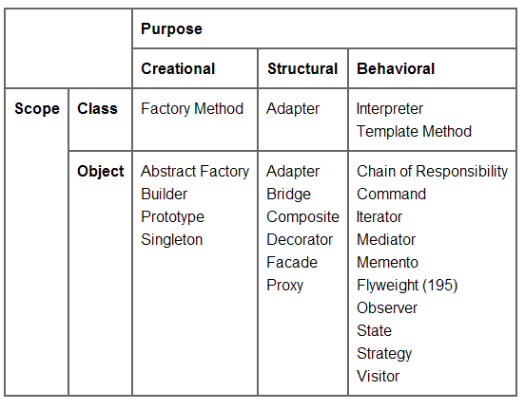
Organizing the Catalog

Slide 63
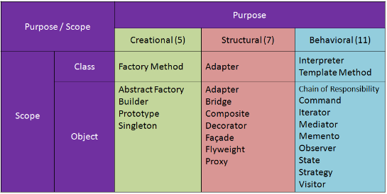
Organizing the Catalog

Slide 64
Topic Objective
Topic : Solving real world problems with design patterns , selection and usage of design patterns.
In this topic, the students will learn how to solve real world problems with design patterns, what are the approaches and Patterns that help in real world problem , how to choose best pattern and what are uses of the patterns.

Slide 65
Solving real world problems with design patterns
Design patterns are conceptual solutions to solve common redundant problems in software engineering. However, learning them is not easy as literature or tutorials on the Internet often introduce them with theoretical examples. This talk gives you a slightly different approach by introducing some of the most useful design patterns with practical code samples to solve real world problems.
Creational Patterns: Abstract Factory and Simple Factory
Structural Patterns: Adapter and Composite
Behavioral Patterns: Mediator

Slide 66
Selection and Usage of design patterns
As there are 23 patterns in the catalog it will be difficult to choose a design pattern. It might become hard to find the design pattern that solves our problem, especially if the catalog is new and unfamiliar to you.
Below is a list of approaches we can use to choose the appropriate design pattern
Consider how design patterns solve design problems:
Considering how design patterns help you find appropriate objects, determine object granularity, specify object interfaces and several other ways in which design patterns solve the problems will let you choose the appropriate design pattern.

Slide 67
Selection and Usage of design patterns
2. Scan intent sections:
Looking at the intent section of each design pattern’s specification lets us choose the appropriate design pattern.
3. Study how patterns interrelate:
The relationships between the patterns will direct us to choose the right patterns or group of patterns.
4. Study patterns of like purpose:
Each design pattern specification will conclude with a comparison of that pattern with other related patterns. This will give you an insight into the similarities and differences between patterns of like purpose.

Slide 68
Selection and Usage of design patterns
5. Examine a cause of redesign:
Look at your problem and identify if there are any causes of redesign. Then look at the catalog of patterns that will help you avoid the causes of redesign.
6. Consider what should be variable in your design:
Consider what you want to be able to change without redesign. The focus here is on encapsulating the concept that varies.

Slide 69
How to use a design patterns
Below steps will show you how to use a design pattern after selecting one:
Read the pattern once through for a overview:
Give importance to the applicability and consequences sections to ensure that the pattern is right for your problem.
2. Study the structure, participants and collaborations sections:
Make sure to understand the classes and objects in the pattern and how they relate to one another.
3. Look at the sample code of the pattern.
Studying the code helps us to implement the pattern.

Slide 70
How to use a design patterns
4. Choose names for pattern participants that are meaningful in the application context:
The names in the design patterns are too abstract to be directly used in the application. Include the participant name into the name that appears in the application which makes the pattern implementation explicit. For example, if you use strategy pattern for developing UI, use UIStartegy or GridStrategy as class names.
5. Define the classes:
Declare their interfaces, inheritance relationships and instance variables, which represent the data and objet references. Identify the effected classes by the pattern and modify them accordingly.

Slide 71
How to use a design patterns
6. Define application-specific names for the operations in the pattern:
Use the responsibilities and collaborations as a guide to name the operations. Be consistent with the naming conventions. For example you can always prefix an operation with “Create-” to denote a factory method.
7. Implement the operations to carry out the responsibilities and collaborations in the pattern:
The implementation section provides hints to guide us in the implementation. The examples in the sample code section can also help as well.

Slide 72
Principle of Least Knowledge
The Principle of Least knowledge:- also known as The law of Demeter, or more precisely, the Law of Demeter for Functions/Methods (LoD-F) is a design principle which provides guidelines for designing a system with minimal dependencies. It is typically summarized as “Only talk to your immediate friends.”
What this means is a client should only have knowledge of an objects members, and not have access to properties and methods of other objects via the members. To put it in simple terms you should only have access to the members of the object, and nothing beyond that. Think if it like this: if you use more than 1 dot you are violating the principle.

Slide 73
Principle of Least Knowledge
A perfect example of The Principle of Least Knowledge is in a Cairngorm Model Locator implementation. The Cairngorm Model Locator violates the Principle of least knowledge for good reason – it simply would not be practical to write wrapper methods for every object on the Model Locator. This is the main drawback of the Principle of least Knowledge; the need to create wrapper methods for each object, which are more formally known as Demeter Transmogrifies.
The goal of good software design is to minimize dependencies, and by carefully following the guidelines provided by The Principle of Least Knowledge this becomes much easier to accomplish.

Slide 74
Daily Quiz
Q 1 - What is Gang of Four (GOF)?
A - Four authors of Book 'Design Patterns - Elements of Reusable Object-Oriented Software' are known as Gang of Four (GOF).
B - Gang of Four (GOF) is a name of a book on Design Patterns.
C - Gang of Four (GOF) is a Design Pattern.
D - None of the above.
Q 2 - Event handling frameworks like swing, awt use Observer Pattern?
A - false
B – true
Q 3 - Which of the following pattern a request is wrapped under an object as command and passed to invoker object?
A - Proxy Pattern
B - Chain of Responsibility Pattern
C - Command Pattern
D - Interpreter Pattern

Slide 75
Daily Quiz
Q 4 - Which of the following describes the Command pattern correctly?
A - In this pattern a class represents functionality of another class.
B - This pattern creates a chain of receiver objects for a request.
C - This pattern provides a way to evaluate language grammar or expression.
D - In this pattern a request is wrapped under an object as command and passed to invoker object.
Q 5 - Which of the following describes the MVC pattern correctly?
A - In this pattern, a visitor class is used which changes the executing algorithm of an element class.
B - This pattern is used to separate application's concerns.
C - This pattern is used to decouple presentation tier and business tier.
D - This pattern is used in EJB persistence mechanism.

Slide 76
Weekly Assignment
What is Software Design Patterns.
What is the Classifying Relationships between Software Design Patterns.
Define textual Analysis Technique
Elaborate Structural Modeling in detail.
Discuss GRASP with example.

Slide 77
Topic Link ( YouTube & NPTEL Video Links)
YouTube /other Video Links
https://youtu.be/rI4kdGLaUiQ?list=PL6n9fhu94yhUbctIoxoVTrklN3LMwTCmd
https://youtu.be/v9ejT8FO-7I?list=PLrhzvIcii6GNjpARdnO4ueTUAVR9eMBpc
https://youtu.be/VGLjQuEQgkI?list=PLt4nG7RVVk1h9lxOYSOGI9pcP3I5oblbx

Slide 78
MCQ (End of Unit)
1. Design patterns are divided into three fundamental groups.
Behavioral Patterns
Creational Patterns
Structural Patterns
J2EE Patterns
2. Four authors _________ are collectively known as Gang of Four (GOF).
Erich Gamma
Richard Helm
Ralph Johnson
John Vlissides
Gavin King

Slide 79
MCQ (End of Unit)
3. Which design pattern provides a single class which provides simplified methods required by client and delegates call to those methods?
Adapter pattern
Builder pattern
Facade pattern
Prototype pattern
4. Which design pattern suggests multiple classes through which request is passed and multiple but only relevant classes carry out operations on the request?
Singleton pattern
Chain of responsibility pattern
State pattern
Bridge pattern

Slide 80
Glossary Questions
Top 10 design pattern interview questions
What are design patterns?
How are design patterns categorized?
Explain the benefits of design patterns in Java.
Describe the factory pattern.
Differentiate ordinary and abstract factory design patterns.
What do you think are the advantages of builder design patterns?
How is the bridge pattern different from the adapter pattern?
What is a command pattern?
Describe the singleton pattern along with its advantages and disadvantages.
What are anti patterns?

Slide 81
Expected Questions for University Exam
What are design patterns?
How are design patterns categorized?
Explain the benefits of design patterns in Java.
Describe the factory pattern.
Differentiate ordinary and abstract factory design patterns.
What do you think are the advantages of builder design patterns?
How is the bridge pattern different from the adapter pattern?
What is a command pattern?
Describe the singleton pattern along with its advantages and disadvantages.
What are anti patterns?

Slide 82
Recap of Unit
Till Now we understand, The idea of a pattern and the definition of terms and concepts,
The idea of design pattern in Smalltalk MVC, what are the model ,view and controller defined by small talk, design pattern in The catalog, we learn how to organized the catalog, learn how to solve real world problems with design patterns, what are the approaches and Patterns that help in real world problem , how to choose best pattern and what are uses of the patterns.
The Principle of Least knowledge, also known as The law of Demeter, or more precisely, the Law of Demeter for Functions/Methods (LoD-F) is a design principle which provides guidelines for designing a system with minimal dependencies.

